Slide 1
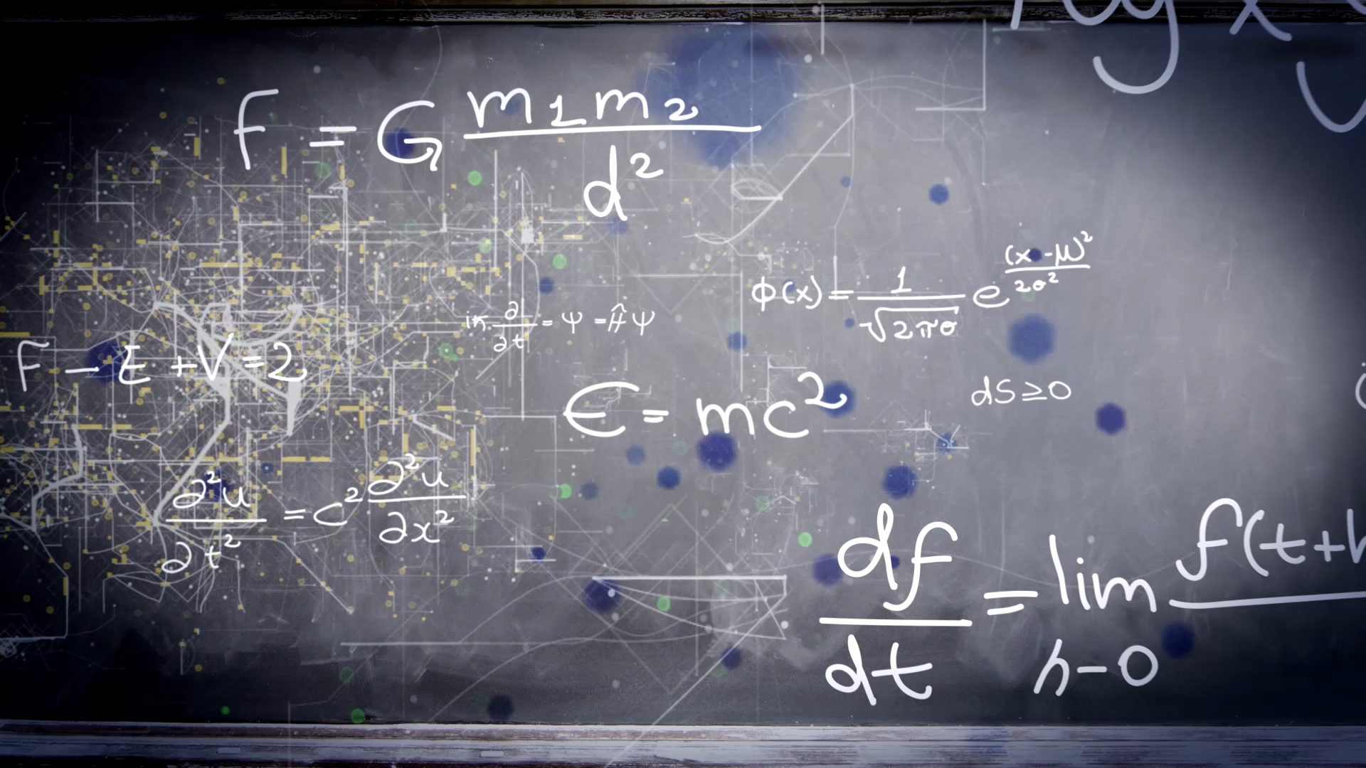
Clustering Algorithms in Unsupervised Machine Learning

Slide 2

agenda
Introduction
K-Means Clustering
Hierarchical Clustering
DBSCAN (Density-Based Spatial Clustering)
Mean Shift Clustering
Spectral Clustering
HDBSCAN (Hierarchical DBSCAN)
OPTICS (Ordering Points to Identify Clustering Structure)
BIRCH (Balanced Iterative Reducing and Clustering using Hierarchies)
Comparative Summary

Slide 3

1. Introduction
Clustering is an unsupervised machine learning technique used to group similar data points into clusters without using labeled data. It helps discover patterns, customer segments, or anomalies in large datasets. The objective is to maximize similarity within clusters and minimize similarity between clusters.

Slide 4
K-Means Clustering
A centroid-based algorithm that divides data into K clusters by minimizing distance between points and cluster centers. It iteratively updates centroids until they stabilize.
Advantages / Limitations: ✅ Fast and simple ❌ Sensitive to outliers, needs K value defined
Common Use Cases: Customer segmentation, image compression
Example Python snippet:
from sklearn.cluster import KMeans model = KMeans() model.fit(X)

Slide 5
Hierarchical Clustering
Builds a tree (dendrogram) of clusters. Agglomerative clustering starts with single points and merges them iteratively.
Advantages / Limitations: ✅ Visual hierarchy view ❌ Slow for large datasets
Common Use Cases: Taxonomy classification, document clustering
Example Python snippet:
from sklearn.cluster import Hierarchical model = Hierarchical() model.fit(X)

Slide 6
DBSCAN (Density-Based Spatial Clustering)
Groups points closely packed together and labels low-density points as noise. It requires two parameters: ε (radius) and minPts.
Advantages / Limitations: ✅ Finds noise and irregular shapes ❌ Fails with varying density
Common Use Cases: Anomaly detection, spatial data analysis
Example Python snippet:
from sklearn.cluster import DBSCAN model = DBSCAN() model.fit(X)

Slide 7
Mean Shift Clustering
Shifts centroids toward the densest area of data points. Automatically detects number of clusters.
Advantages / Limitations: ✅ No need to predefine K ❌ Computationally heavy
Common Use Cases: Image segmentation, tracking
Example Python snippet:
from sklearn.cluster import Mean model = Mean() model.fit(X)

Slide 8
Spectral Clustering
Uses graph theory and eigenvalues of similarity matrices to partition data into groups. Works well for non-convex shapes.
Advantages / Limitations: ✅ Works with complex structures ❌ Computationally expensive
Common Use Cases: Image segmentation, social network analysis
Example Python snippet:
from sklearn.cluster import Spectral model = Spectral() model.fit(X)

Slide 9
HDBSCAN (Hierarchical DBSCAN)
An advanced version of DBSCAN that builds a hierarchy of clusters and extracts the most stable ones.
Advantages / Limitations: ✅ Handles variable density ❌ More complex to tune
Common Use Cases: Customer behavior analysis, anomaly detection
Example Python snippet:
from sklearn.cluster import HDBSCAN model = HDBSCAN() model.fit(X)

Slide 10
OPTICS (Ordering Points to Identify Clustering Structure)
Similar to DBSCAN but creates an ordered reachability plot instead of explicit clusters, handling varying densities better.
Advantages / Limitations: ✅ Handles complex densities ❌ Harder to interpret
Common Use Cases: Geospatial analysis, anomaly detection
Example Python snippet:
from sklearn.cluster import OPTICS model = OPTICS() model.fit(X)

Slide 11
BIRCH (Balanced Iterative Reducing and Clustering using Hierarchies)
Incremental clustering algorithm using a tree structure (CF tree) to handle large datasets efficiently.
Advantages / Limitations: ✅ Scales well for big data ❌ Sensitive to input order
Common Use Cases: IoT data analysis, log pattern detection
Example Python snippet:
from sklearn.cluster import BIRCH model = BIRCH() model.fit(X)

Slide 12
Comparative Summary
Algorithm | Needs K? | Handles Noise | Cluster Shape | Best For
K-Means | ✅ | ❌ | Spherical | Simple & fast grouping
Hierarchical | ❌ | ❌ | Any | Relationship discovery
DBSCAN | ❌ | ✅ | Arbitrary | Noise-rich data
Mean Shift | ❌ | ✅ | Any | Auto cluster detection
GMM | ✅ | ❌ | Elliptical | Probabilistic clusters
Spectral | ✅ | ✅ | Complex | Graph-based clustering
HDBSCAN | ❌ | ✅ | Any | Variable density data
OPTICS | ❌ | ✅ | Any | Varying densities
BIRCH | ✅ | ❌ | Hierarchical | Large-scale data
A comparison of key clustering algorithms based on major factors:

Slide 13

THANK YOU

